Slide 1
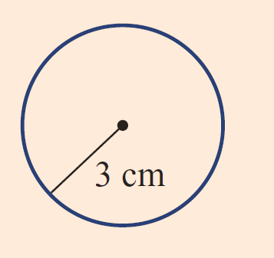
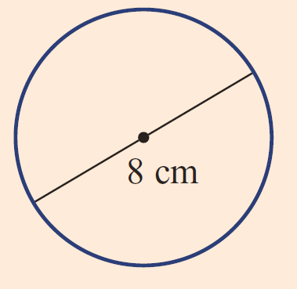
Practice
Find the circumference of the two circles

Slide 2
Area of a Circle
EQ – How do you find the area of parts of a Circle?
Mrs Stretch
Year 8

Slide 3
Learning Intentions
Students will be able to
Find the area of a circle, semicircle and a quadrant

Slide 4
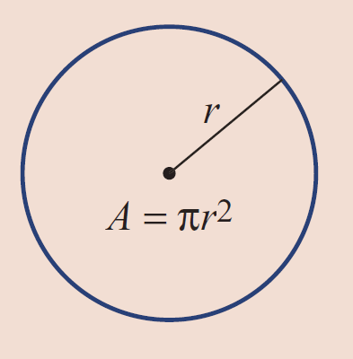


24
7
30
Area of a Circle
Date
EQ – How do you find the area of parts of a Circle?
Area of a Full Circle
$$A=πr^{2}$$
If you have a circle with a diameter you will need to half it in order to find the radius.

Slide 5
Practice
Find the area.

Slide 6
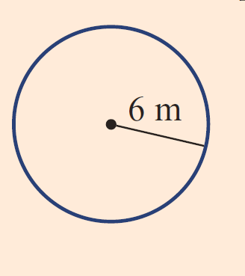
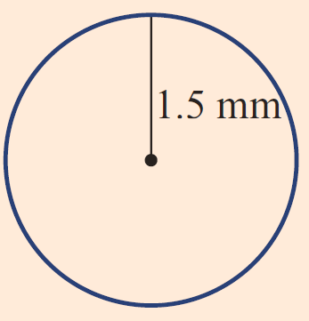
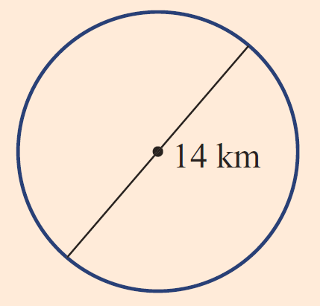
Practice
Find the area.

Slide 7


Slide 8
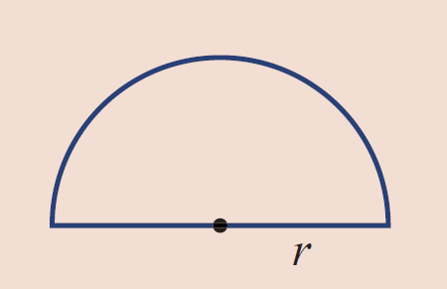


24
7
30
Area of a Circle
Date
EQ – How do you find the area of parts of a Circle?
Area of a Semi Circle
$$A=\frac{1}{2}πr^{2}$$
A Semi-Circle is half a full circle
Again if you get given the diameter you need to half it to get the radius.

Slide 9
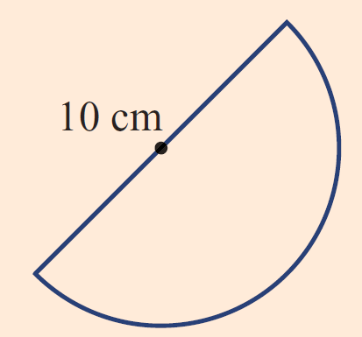
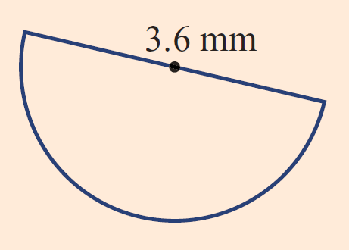
Practice
Find the area.

Slide 10
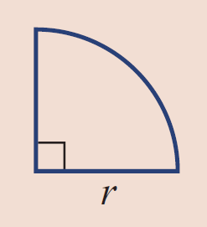

24
7
30
Area of a Circle
Date
EQ – How do you find the area of parts of a Circle?
Area of a Quadrant
$$A=\frac{1}{4}πr^{2}$$
A Quadrant is a quarter of a circle.

Slide 11
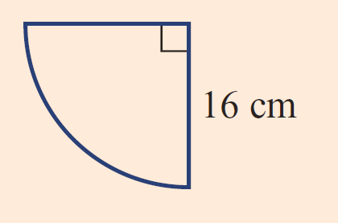
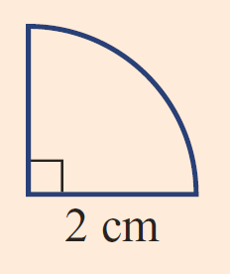
Practice
Find the area.

Slide 12
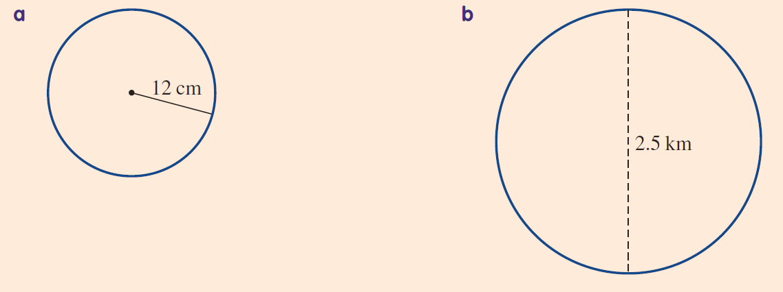
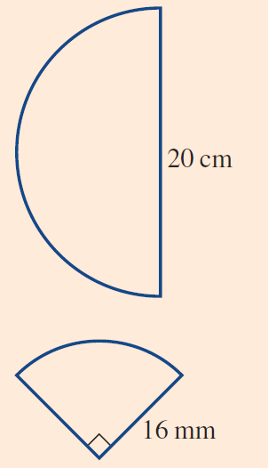
Task
Find the area of the following circles, semi-circles and quadrants

